Slide 1


Presentation on
Telecom Customer Churn Analysis
Presented by :
Name : B. Bhanu Sai Prakash
Batch No : 436
Branch : Dilsukhnagar

Slide 2
About me
  I am Bhanu Sai Prakash Bandaru.
  I completed my B.Tech in Computer Science and Engineering from M.V.G.R College of Engineering(Vizianagaram).
  Linkedin : https://www.linkedin.com/in/bhanu-sai-prakash-bandaru-22a1b8204/
  Github : https://github.com/bhanusaiprakashbandaru

Slide 3
Agenda
Introduction
Problem Statement
Objectives
Data Collection & Cleaning
Dashboard Navigation / Overview
Dashboards (Demographics → Services → Contract & Billing → Key Drivers)
Executive Summary
Business Recommendations to Reduce Churn
Conclusion
Q&A

Slide 4
Introduction
The Telecom Customer Churn Analysis project aims to understand why customers discontinue their telecom services and identify the key factors that influence churn. Telecom companies collect large amounts of customer data, including demographics, service subscriptions, billing details, and usage patterns, but much of this information remains unused for business decision-making.
By analyzing this dataset in Power BI, we can uncover hidden patterns in customer behavior, identify high-risk groups, and understand which services or contract types drive churn. This enables the company to take proactive actions to reduce customer loss.
The interactive dashboard provides meaningful insights that support customer retention, revenue protection, and strategic decision-making for telecom organizations.

Slide 5
Problem Statement
Telecom companies face difficulty understanding why customers discontinue their services.
Without proper churn insights, they struggle to:
  Identify high-risk customers before they leave
  Understand which services, payment methods, or contract types contribute to churn
  Detect early-stage churn indicators such as low tenure or high monthly charges
  Design targeted retention strategies for specific customer segments
  Reduce revenue loss caused by customer churn
This project aims to address these issues by using Power BI to analyze and visualize telecom customer data, enabling faster and more accurate decision-making.

Slide 6
Objective
To analyze customer demographics and understand behavioral patterns
To study the impact of internet service type and add-on services on customer retention
To compare churn rates across different contract types and payment methods
To identify high-risk customer segments based on tenure, charges, and service usage
To build interactive dashboards using Power BI for quick decision-making
To provide actionable recommendations to reduce customer churn and improve retention

Slide 7
Steps for Collecting the Data
Identify Data Source:
The dataset was sourced from a telecom provider’s customer management system, which records customer details, subscribed services, contract information, billing preferences, and churn status.
Select Required Fields:
Important fields such as customer ID, gender, senior citizen flag, tenure, internet service type, phone service, add-on services, contract type, billing preferences, payment method, and monthly/total charges were selected for analysis.
Churn Indicator:
A churn column is included, indicating whether the customer left the service ("Yes") or stayed ("No").
Export Data:
The dataset was exported into a CSV file for easy processing and compatibility with Power BI.
Load Data into Power BI:
The CSV file was imported into Power BI, where the data was explored, cleaned, and transformed for dashboard creation.

Slide 8
Data Cleaning Steps
Checked and fixed missing values in important columns like Total Charges, Tenure, and Monthly Charges.
Standardized category names, for example combining "No internet service" with "No" to avoid confusion.
Created useful DAX measures such as Churn Rate, Churn Count, and Average Tenure for better analysis.
Grouped Tenure into clear segments like 0–12 Months, 13–24 Months, and 25+ Months to study customer lifecycle.
Verified all data types (text, number, dates) to make sure calculations and visuals work correctly.

Slide 9
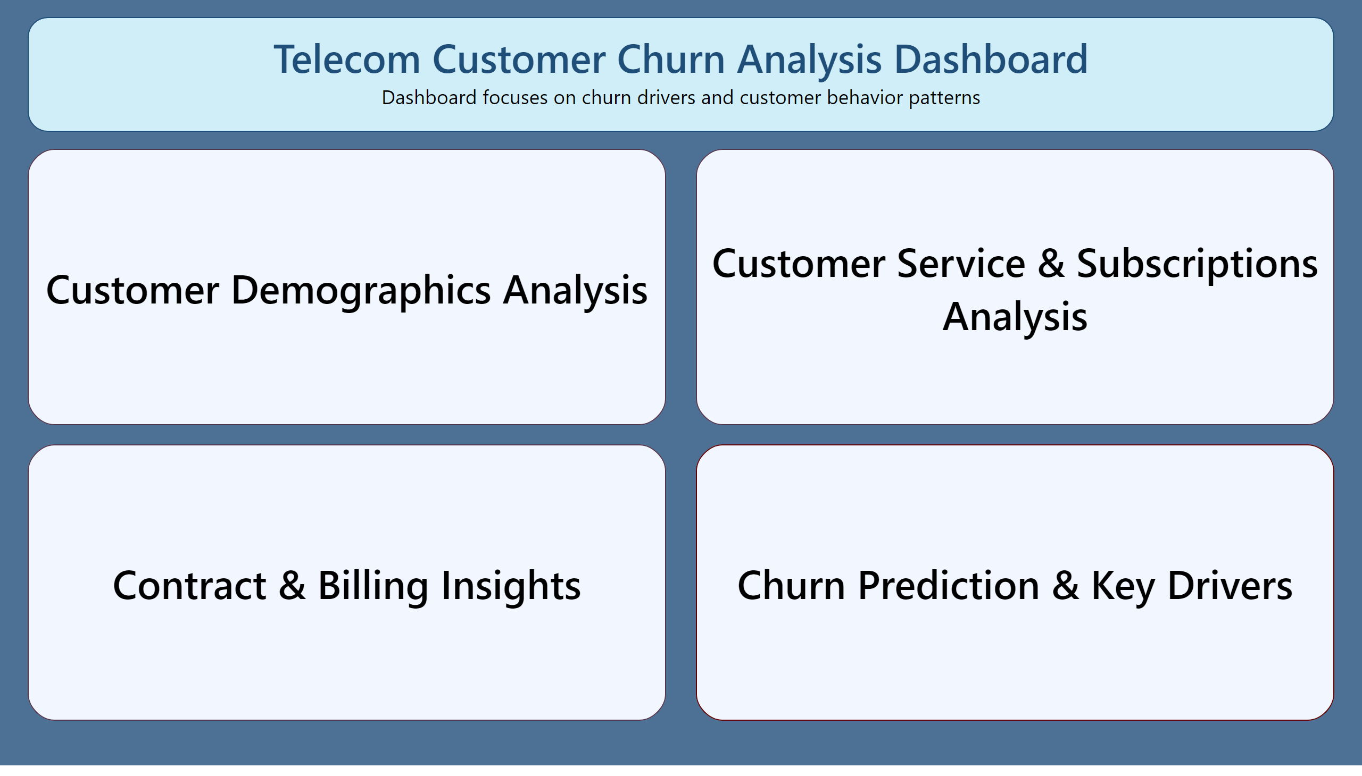
Main
Dashboard Overview
This dashboard is divided into four analytical sections to understand customer churn from different perspectives.
Dashboard is divided into four sections:
Customer Demographics Analysis
Demographic factors and churn behavior.
Customer Service & Subscriptions Analysis
Impact of service usage and add-ons on churn.
Contract & Billing Insights
How contract types and payment methods affect churn.
Churn Prediction & Key Drivers
Major churn drivers and business impact.
Notes:
textbox
No alt text provided
textbox
No alt text provided
shape
No alt text provided
shape
No alt text provided
shape
No alt text provided
shape
No alt text provided

Slide 10
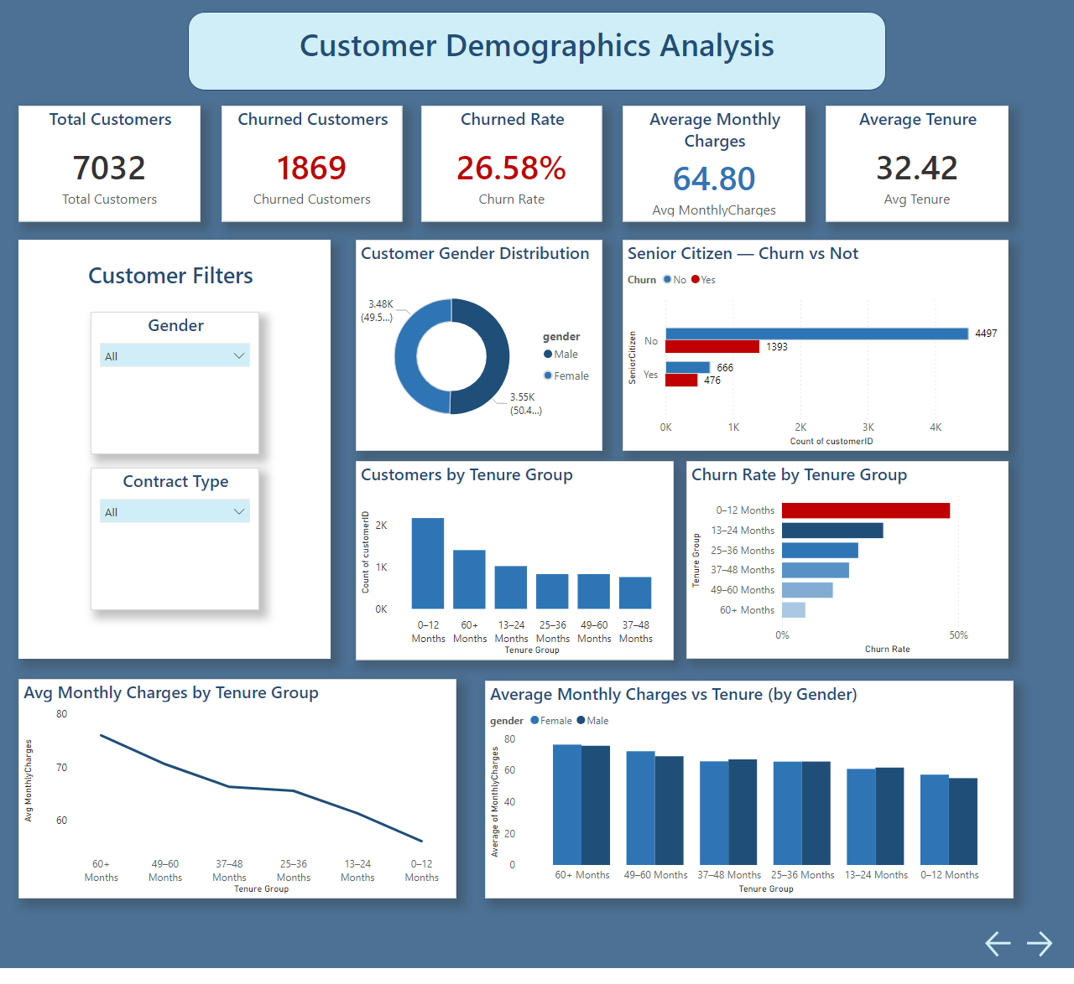
Demographics
Notes:
textbox
No alt text provided
Average Monthly Charges vs Tenure (by Gender)
No alt text provided
Avg Monthly Charges by Tenure Group
No alt text provided
Total Customers
No alt text provided
Churned Customers
No alt text provided
Churned Rate
No alt text provided
Average Monthly Charges
No alt text provided
Average Tenure
No alt text provided
actionButton
No alt text provided
actionButton
No alt text provided
Senior Citizen — Churn vs Not
No alt text provided
Customer Gender Distribution
No alt text provided
Gender
No alt text provided
Contract Type
No alt text provided
textbox
No alt text provided
shape
No alt text provided
Churn Rate by Tenure Group
No alt text provided
Customers by Tenure Group
No alt text provided

Slide 11
Key Insights:
Male and female customers are almost equal in count, so gender does not bias the dataset.
Senior citizens churn more than non-senior customers, showing they are a vulnerable segment.
Most customers fall in lower-tenure groups (0–12 months) — this group also has the highest churn rate.
Churn rate steadily decreases as tenure increases, meaning customers who stay longer are less likely to leave.
Average monthly charges decline with higher tenure, indicating long-term customers often receive better pricing or discounts.
Monthly charges vs tenure (by gender) shows both genders follow the same pattern, so gender does not influence spending behavior.

Slide 12
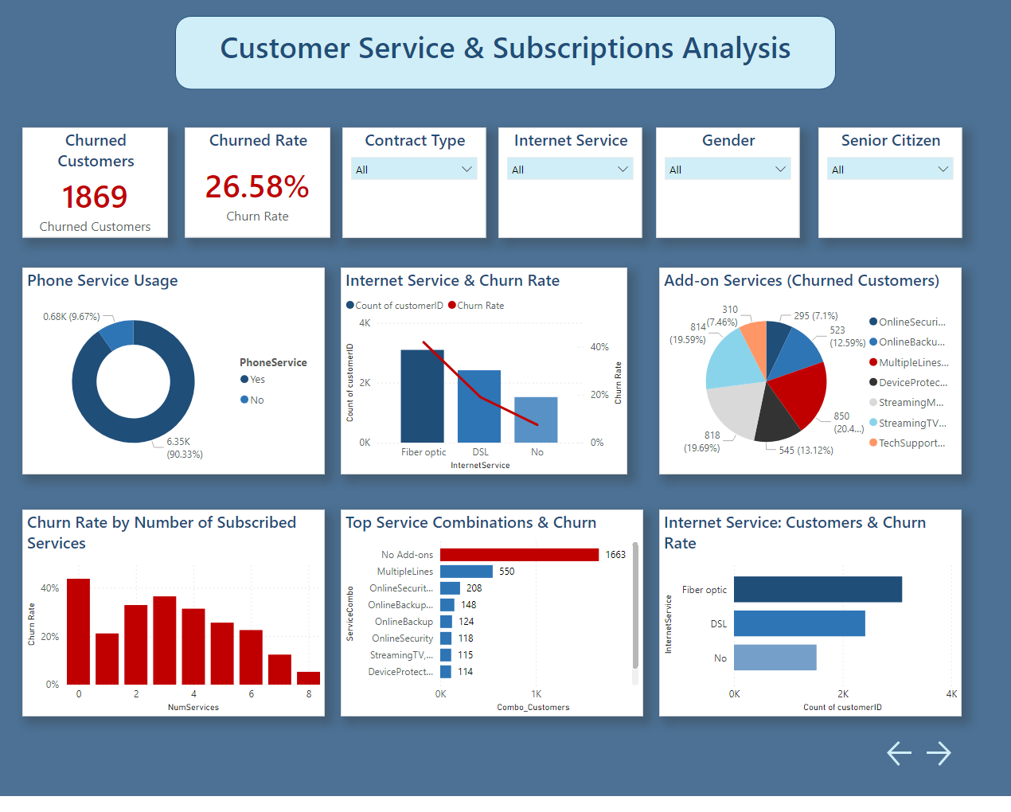
Services
Notes:
Phone Service Usage
No alt text provided
Internet Service & Churn Rate
No alt text provided
Add-on Services (Churned Customers)
No alt text provided
Churn Rate by Number of Subscribed Services
No alt text provided
Top Service Combinations & Churn
No alt text provided
Internet Service: Customers & Churn Rate
No alt text provided
Churned Rate
No alt text provided
Churned Customers
No alt text provided
Contract Type
No alt text provided
Internet Service
No alt text provided
Gender
No alt text provided
Senior Citizen
No alt text provided
actionButton
No alt text provided
actionButton
No alt text provided
textbox
No alt text provided

Slide 13
Key Insights:
Most customers use phone service, but phone service itself has little influence on churn.
Fiber optic users churn the most, while DSL and no-internet customers churn less.
Churn is higher for customers using multiple add-on services, especially security and cloud-related services.
Churn increases as the number of subscribed services increases, indicating service complexity or cost may cause dissatisfaction.
The most common churn combinations include: Fiber optic + Security add-ons and Multiple add-ons.
Fiber optic has the highest customer count and highest churn count, making it the most critical service to improve.

Slide 14
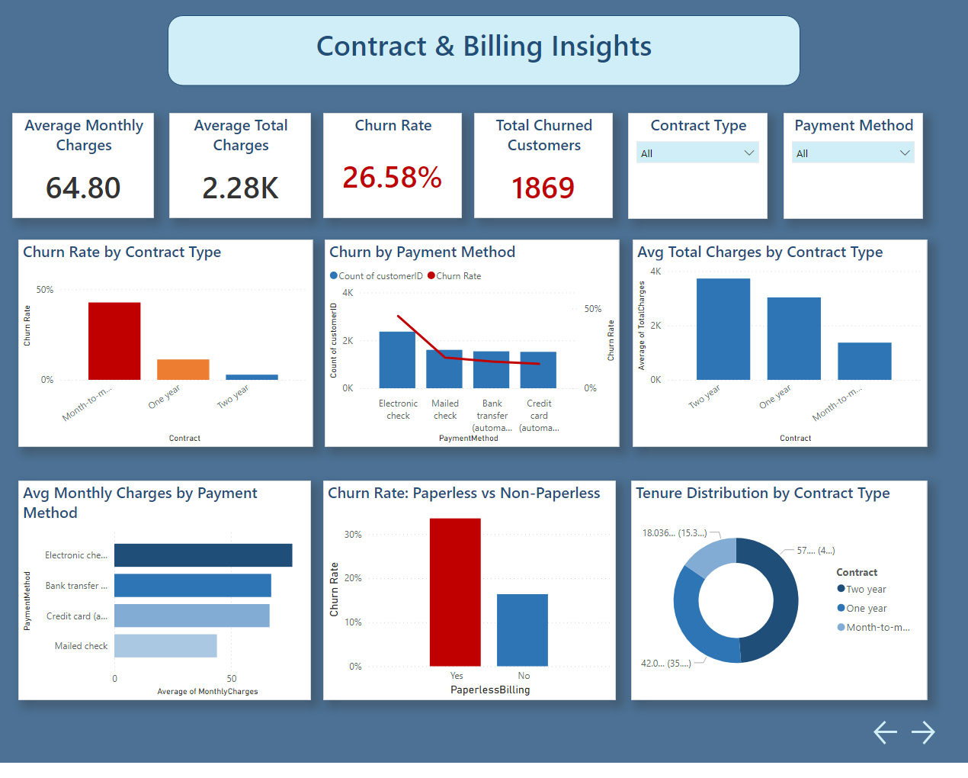
Contract & Biling
Notes:
Churn Rate by Contract Type
No alt text provided
Churn by Payment Method
No alt text provided
Avg Total Charges by Contract Type
No alt text provided
Avg Monthly Charges by Payment Method
No alt text provided
Churn Rate: Paperless vs Non-Paperless
No alt text provided
Tenure Distribution by Contract Type
No alt text provided
Churn Rate
No alt text provided
Average Monthly Charges
No alt text provided
Average Total Charges
No alt text provided
Total Churned Customers
No alt text provided
Contract Type
No alt text provided
Payment Method
No alt text provided
actionButton
No alt text provided
actionButton
No alt text provided
textbox
No alt text provided

Slide 15
Key Insights:
Month-to-month customers churn the most, while one-year and two-year contracts churn significantly less.
Electronic check users have the highest churn, making it the riskiest payment method.
Total charges are highest for two-year contract customers, meaning long-term customers generate the most revenue.
Monthly charges vary across payment methods, but churn is mostly driven by contract type and payment type.
Paperless billing users churn more, indicating communication or billing experience issues.
Tenure distribution by contract type shows month-to-month has many short-tenure customers, explaining high churn.
Key billing metrics (avg monthly charges, total charges, churn rate) combined confirm that contract length is the strongest billing factor influencing churn.

Slide 16
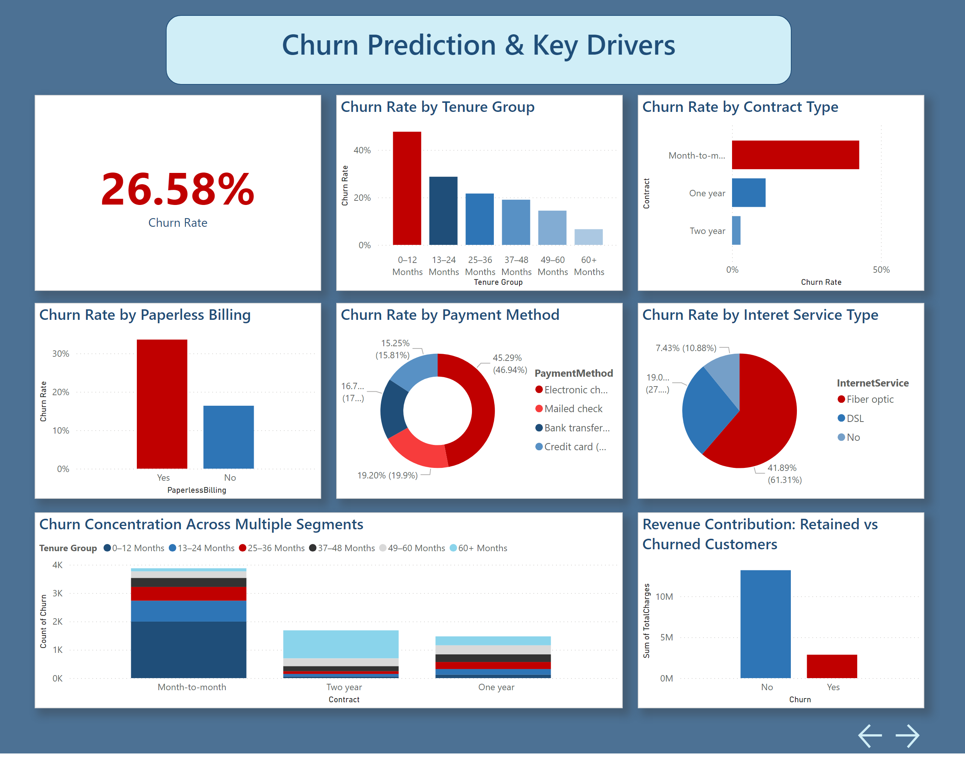
Key drivers
Notes:
Churn Rate by Contract Type
No alt text provided
Churn Rate by Tenure Group
No alt text provided
Overall Churn Rate
No alt text provided
actionButton
No alt text provided
actionButton
No alt text provided
Churn Rate by Paperless Billing
No alt text provided
Churn Rate by Payment Method
No alt text provided
Churn Rate by Interet Service Type
No alt text provided
Churn Concentration Across Multiple Segments
No alt text provided
Revenue Contribution: Retained vs Churned Customers
No alt text provided
textbox
No alt text provided

Slide 17
Key Insights:
The overall churn rate is 26.58%.
Churn is strongly influenced by:
  Contract Type → Month-to-month has the highest churn.
  Tenure → Low-tenure customers churn the most.
  Internet Service → Fiber optic users show the highest churn.
  Payment Method → Electronic check users churn heavily.
  Paperless Billing → Higher churn than non-paperless users.
High-risk customer segments:
  New customers (0–12 months)
  Month-to-month users
  Fiber optic users
  Electronic check users
Total revenue is much higher from retained customers, confirming that churn directly reduces revenue.

Slide 18
Executive Summary
Analyzed 7,032 telecom customers to understand churn behavior.
Identified an overall churn rate of 26.58%, which is high for the telecom industry.
Churn is most common among month-to-month contract customers, fiber optic users, and customers with tenure below 12 months.
Customers using electronic check and paperless billing show higher churn.
Customers with multiple add-on services tend to stay longer.
The dashboard helps identify high-risk customers and key churn drivers for better decision-making.

Slide 19
Business Recommendations to Reduce Churn
Encourage month-to-month customers to shift to long-term contracts using discounts or offers.
Improve fiber optic service quality and customer support.
Focus retention campaigns on new customers (0–12 months tenure).
Promote add-on services such as Online Security and Device Protection.
Encourage auto-payment methods instead of electronic checks.
Create targeted plans for senior citizens with simple pricing and support.

Slide 20
Summary page
Conclusion
Customer churn in the telecom business is strongly influenced by contract type, tenure, service usage, and billing behavior.
Short-tenure and month-to-month customers are the most vulnerable to churn.
Power BI enabled clear identification of high-risk customer segments through interactive dashboards.
By acting on these insights, telecom companies can reduce churn, improve retention, and protect revenue.
This project demonstrates how data-driven analysis supports better business decisions.
Notes:
textbox
No alt text provided
textbox
No alt text provided
textbox
No alt text provided
textbox
No alt text provided
textbox
No alt text provided
textbox
No alt text provided
textbox
No alt text provided
textbox
No alt text provided
actionButton
No alt text provided

Slide 21
?
Any
Questions

Slide 22

Thank you

